Slide 1
Capstone Project - The Battle of Neighborhoods
WT CHOW

Slide 2
Question – Where to open a gym/fitness center?
Stakeholders – gym owners
Gym owners wish to open a gym/fitness center at prime locations where gym/fitness centers are more preferred over other fitness facilities.

Slide 3
Data acquisition and cleaning
New York neighborhood details
306 neighborhoods in dataset
New York neighborhood geospatial details
Venue details in New York
1,666 fitness related facilities in dataset

Slide 4
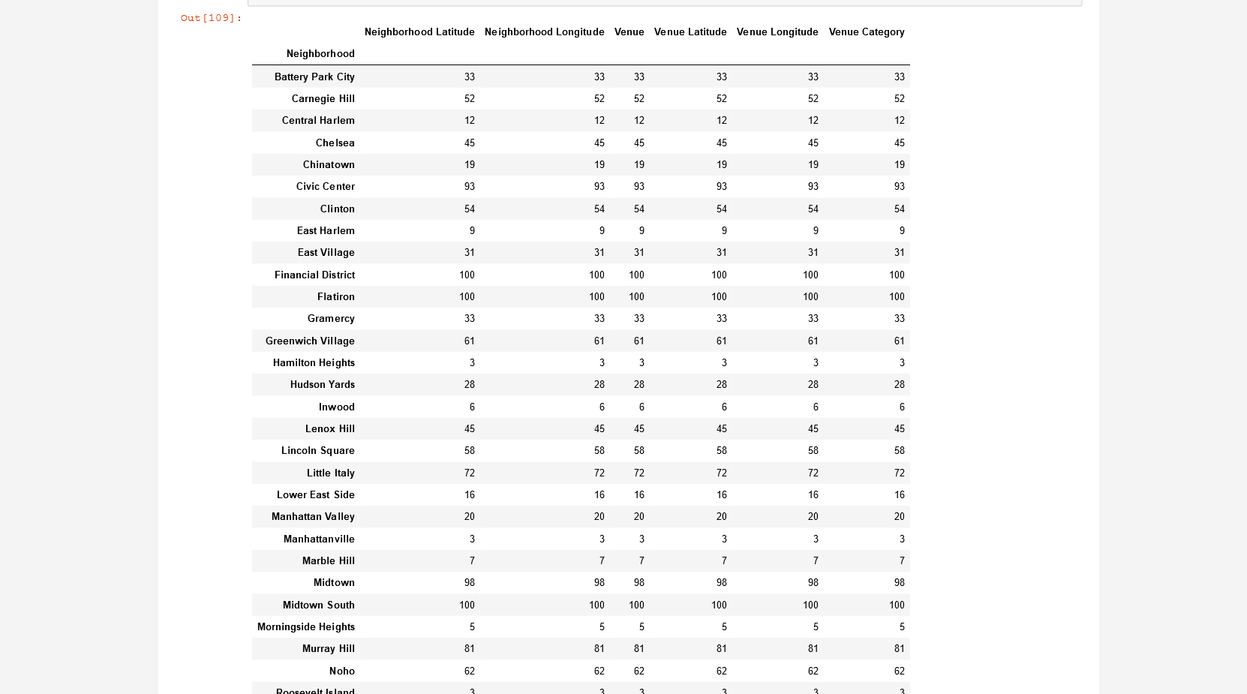
Result

Slide 5
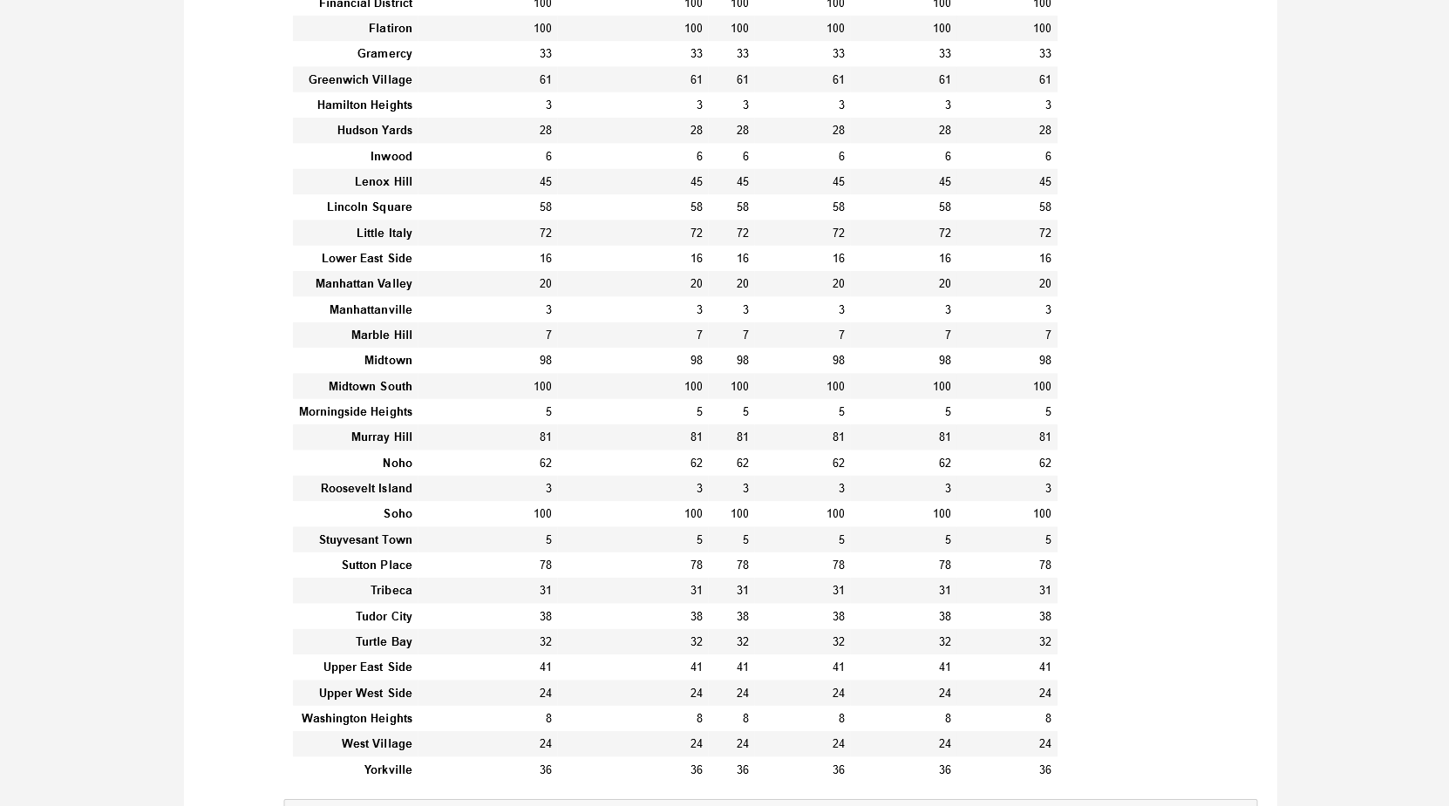
Result Cont’d

Slide 6

Result Cont’d

Slide 7
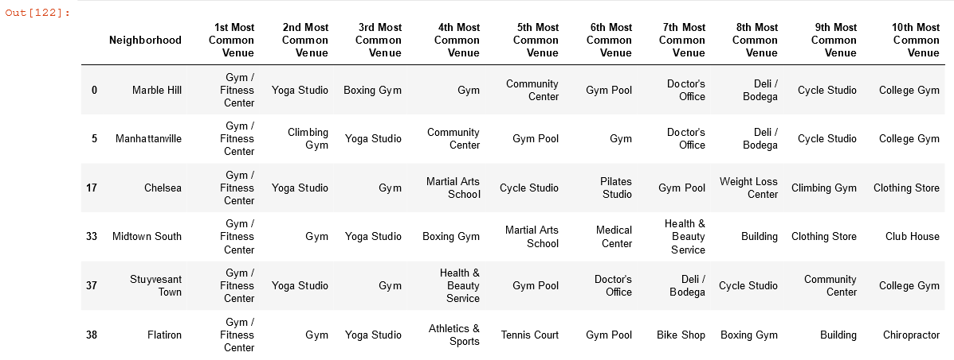
Result Cont’d

Slide 8
Conclusion
Neighborhoods with highest number of fitness venues
Financial District (100), Flatiron (100), Soho (100), Civic Center (93)
First most common venue
Financial District – Gym
Flatiron – Gym/fitness center
Soho – Gym/fitness center
Civic Center – Gym/fitness center

